Slide 1

ChAMps Travel
Your time is valuable, so is your money.
Project 3
Abraham Benaim
Craig Hall
Mon Alarcon

Slide 2
You may remember…
Define the problem:
It takes too long for an individual to manually search different iterations of flight routes to the same set of cities
Although multi-city flight searches exist, the users must have defined dates which leads to opportunity costs of finding a cheaper priced route
User may still not get the best available options if manually searching

Slide 3
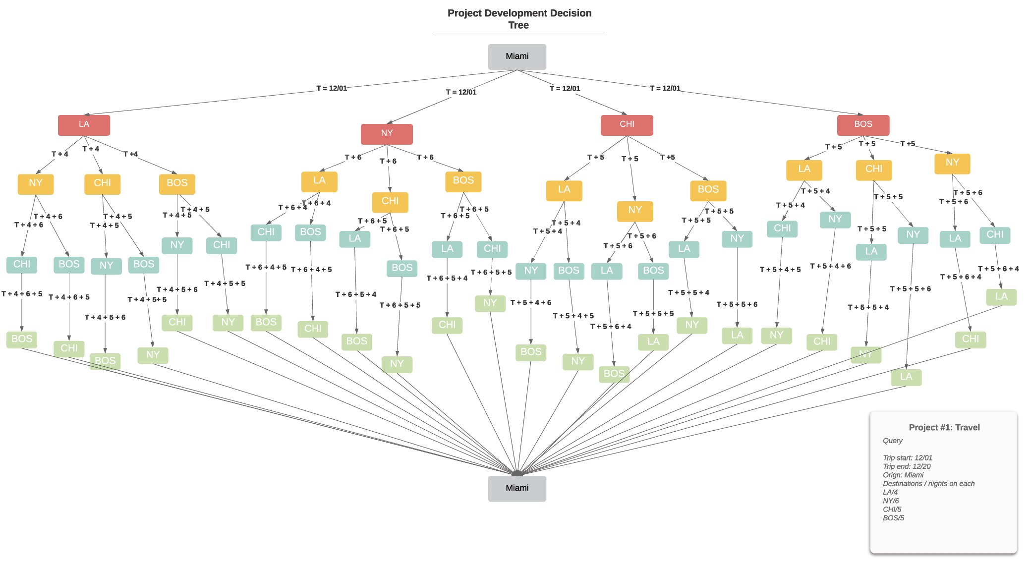

Slide 4
Additional Functionality
How could we use our additional skills to improve the multi-city search experience?
Identify and display if a visa will be needed for the destination country/countries (for work or tourism)
Display current travel advisories for the selected destinations
Display historical weather for the destination cities during the identified travel period
Display top three attractions for the destination city
Display a map of travel routes with popup information for each destination city, containing visa requirements and travel advisory

Slide 5
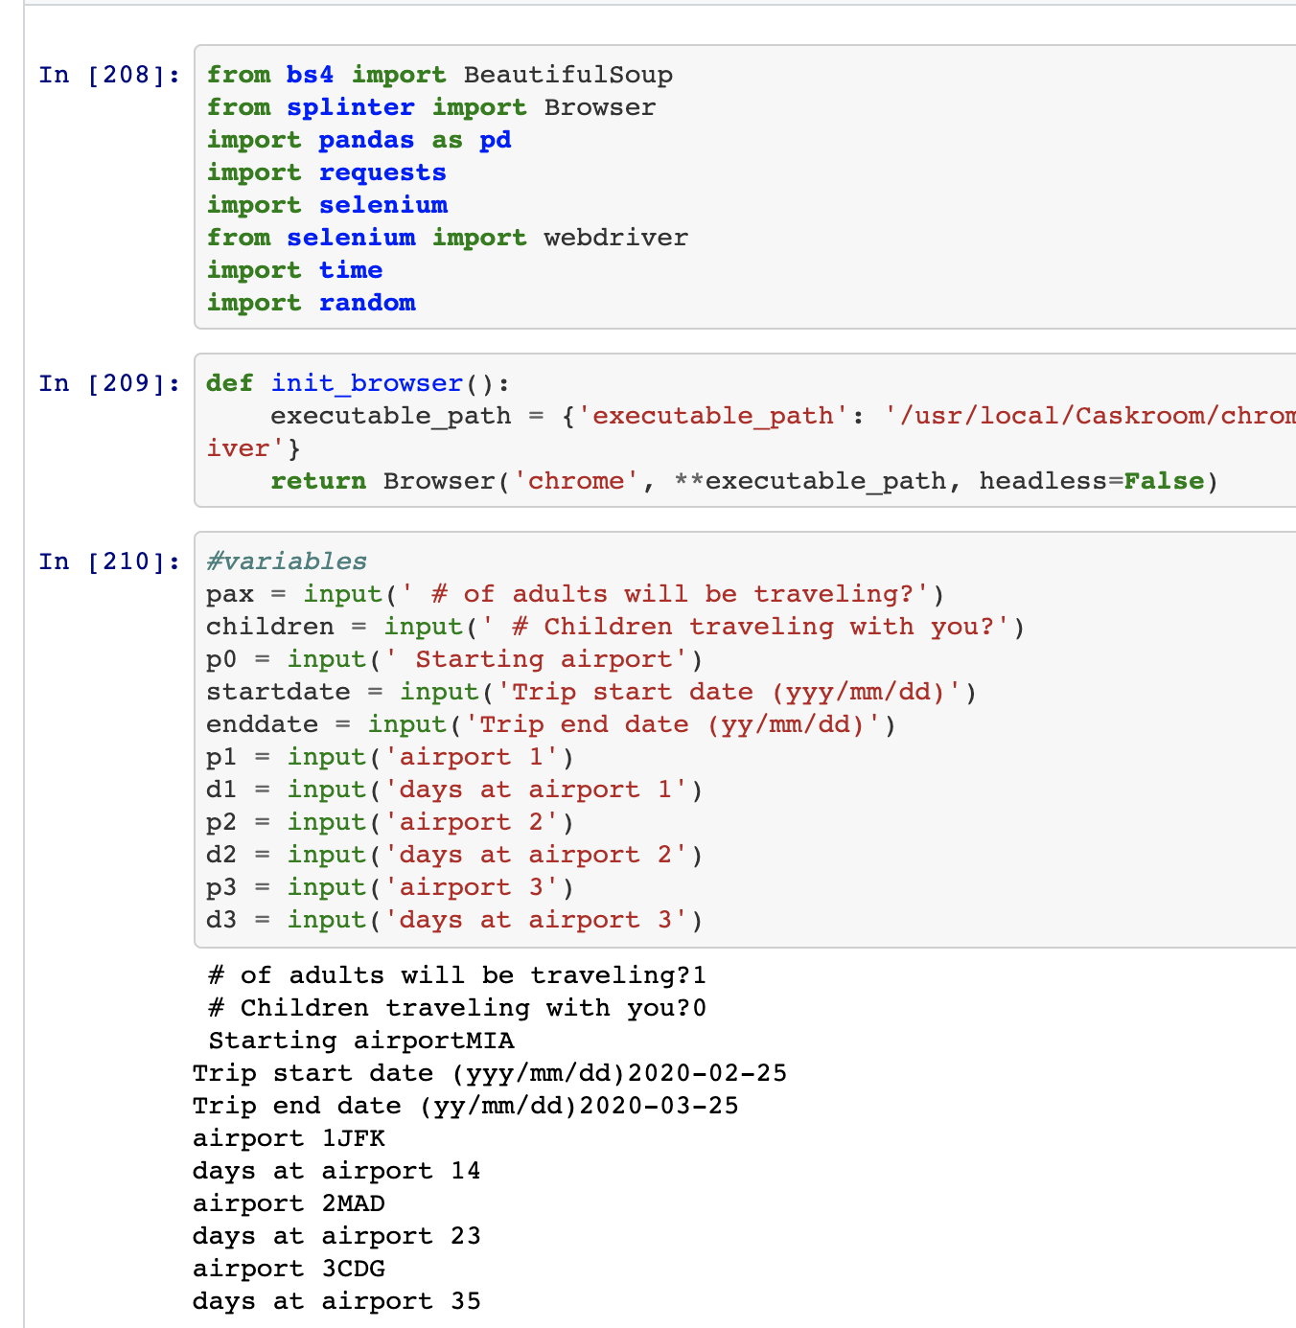
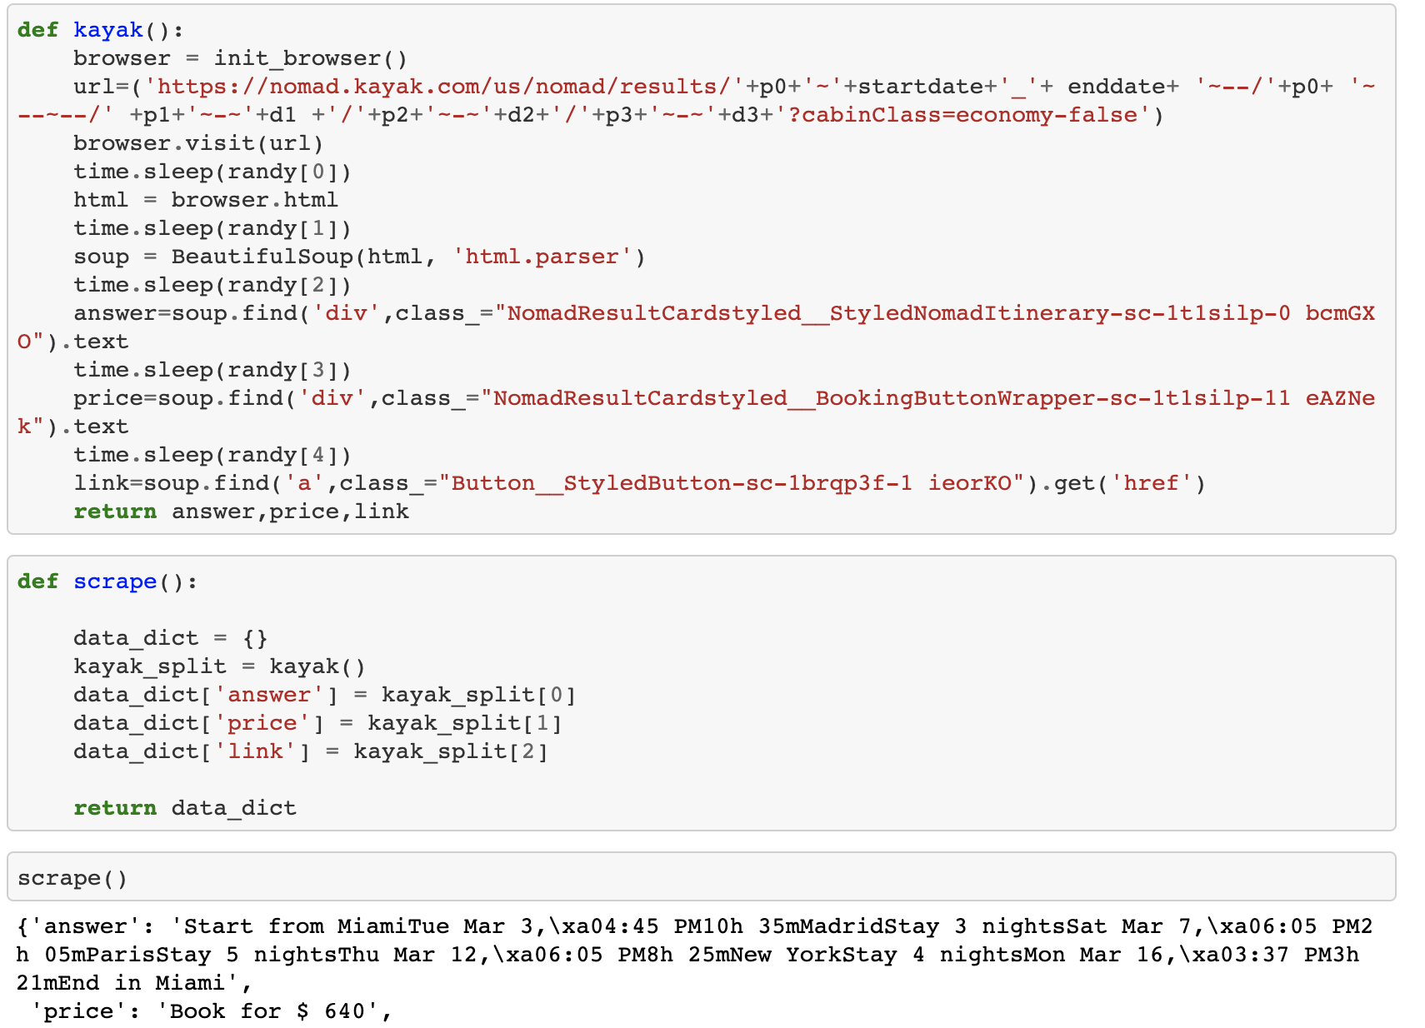
Process
1. Build upon previous Python code that searched all available routes and returned the cheapest flight routes.
We use Kiwi’s (Kayak) itineraries database to find the best route

Slide 6
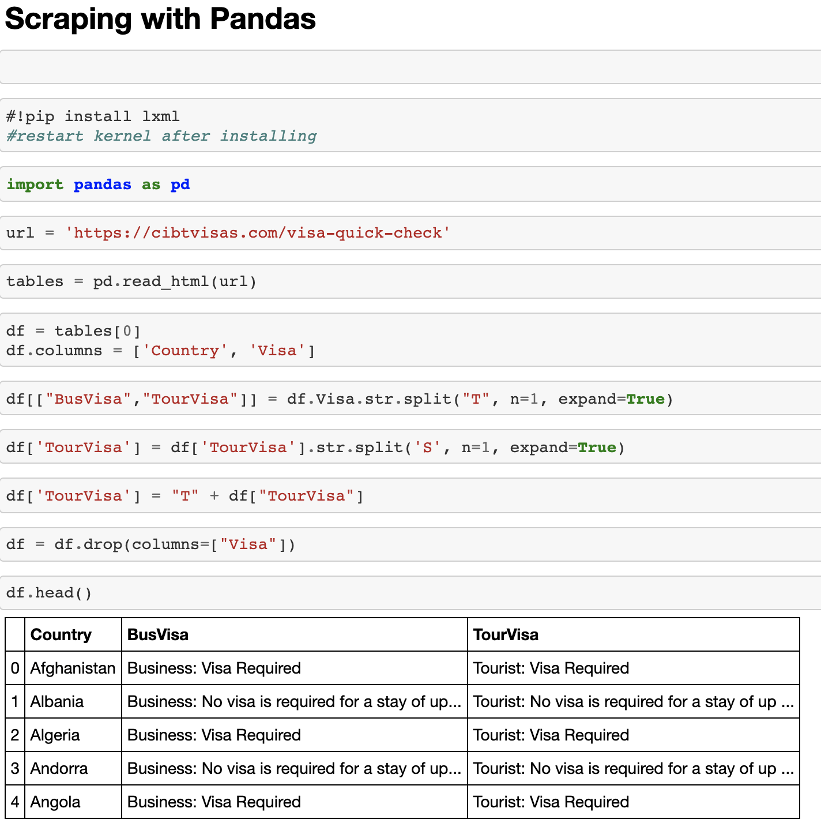
Process
2. Build a visa requirements retrieval code for the trip planned.
The data used for this is coming straight from the USA Gov website. And will provide in-detail information for visa requirements at the moment of flying to the user destination.

Slide 7
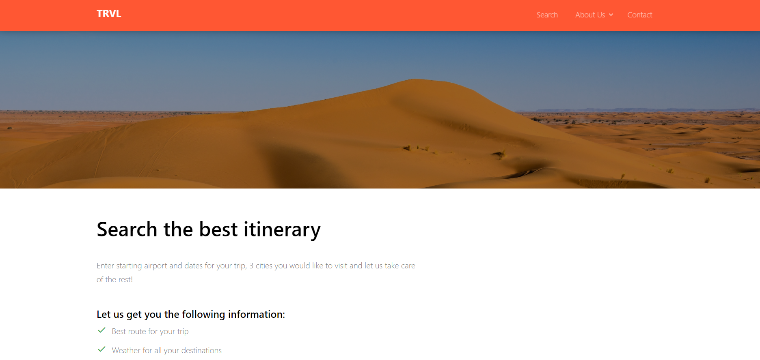
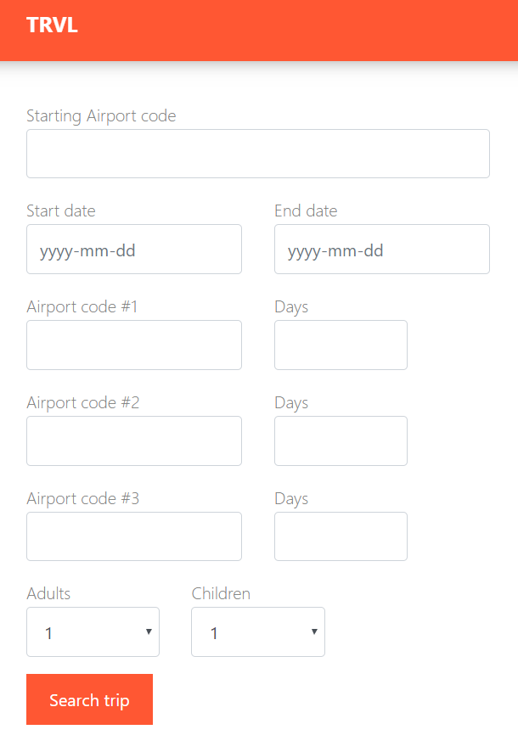
3. Build HTML page that displays the search fields and will return the results
4. Use D3 to capture the destination cities from the input fields in the html file / website; create a list of destination cities

Slide 8
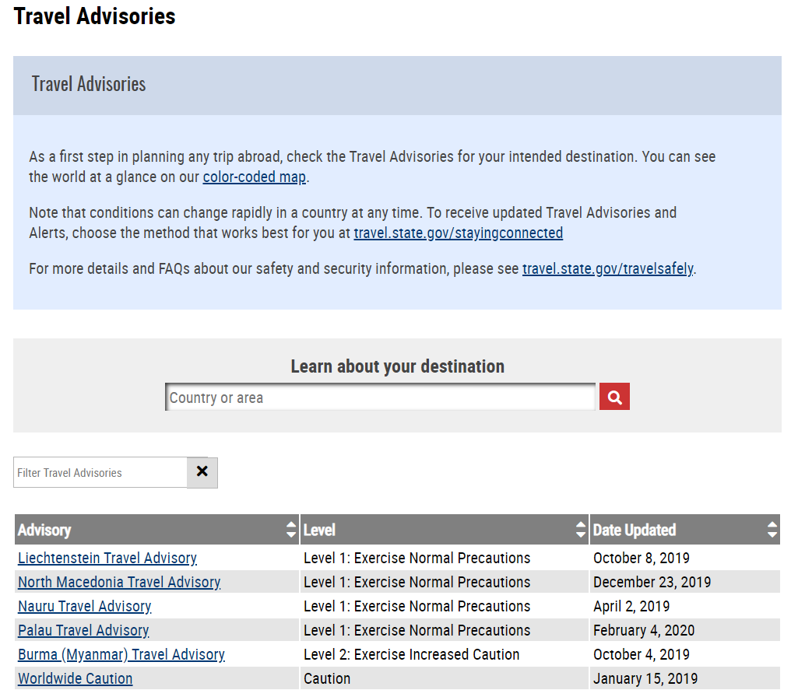
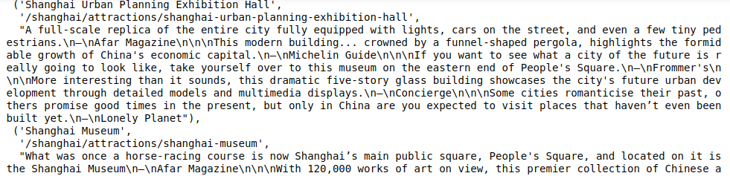
4. Use Python, Splinter, Selenium, Beautiful Soup and the list of destination cities to:
visit the CIBT website, identify the visa requirements for those cities, scrape the results
Visit US Department of State website to check travel advisories for destination cities, scrape and store results
Visit TripExpert.com to identify and scrape the top three attractions for destination cities

Slide 9
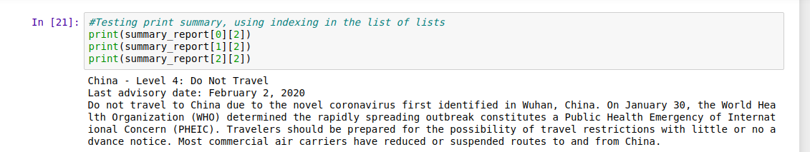
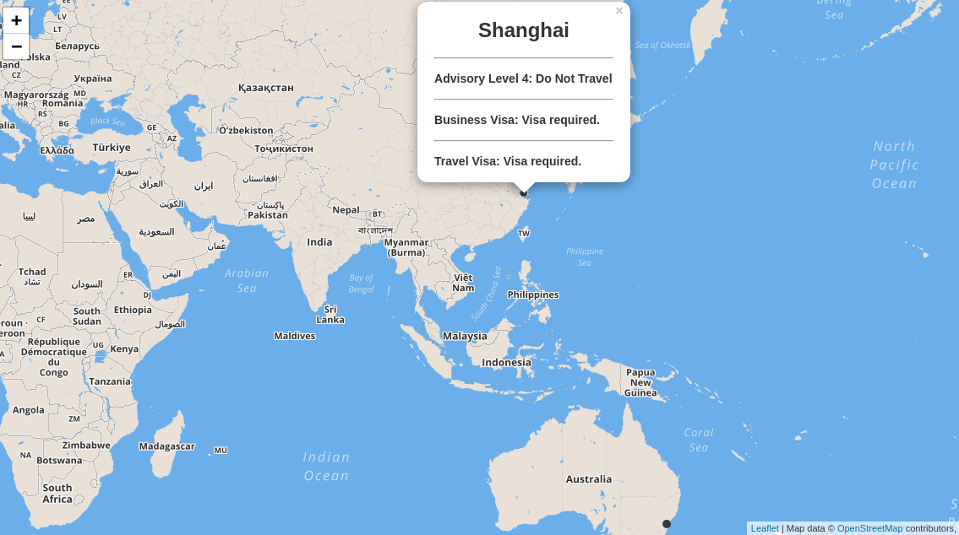
5. Use API call to Globe.gov for historical global weather
6. Use JavaScript and Leaflet to create a map of the specified travel destinations with pop-ups specifying visa requirements and travel advisories
7. Use MongoDB to store all data for destination cities (visa requirements, travel advisories, historical weather conditions for specified travel dates); chose to use MongoDB because its structure allows us to continue to add fields and functionality
8. Return the results of the cheapest routes to visit destination cities and other city info (visa, travel advisory, weather, top 3 attractions)

Slide 10
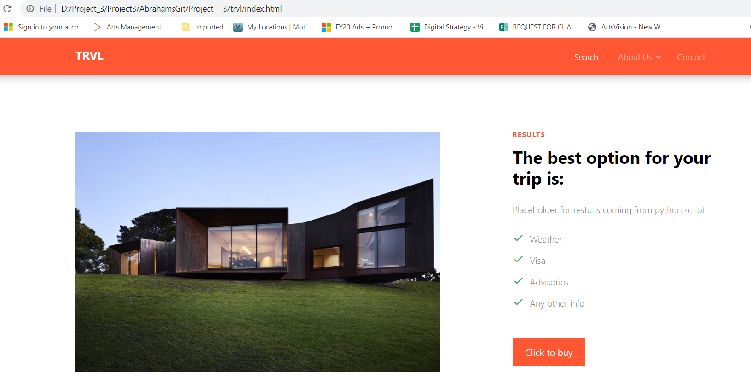
9. Use Flask to display results for destination cities, feed results into HTML page

Slide 11
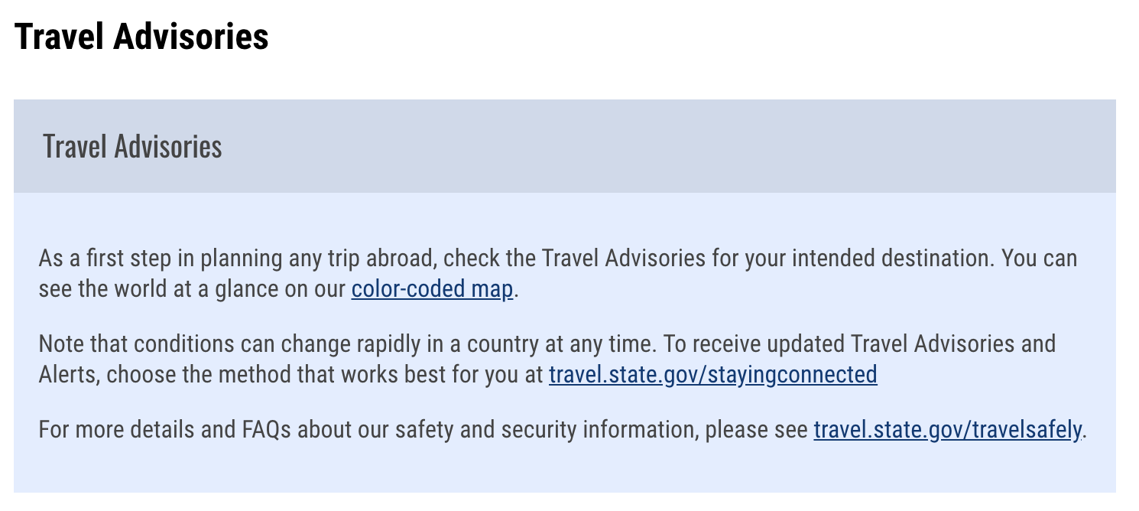
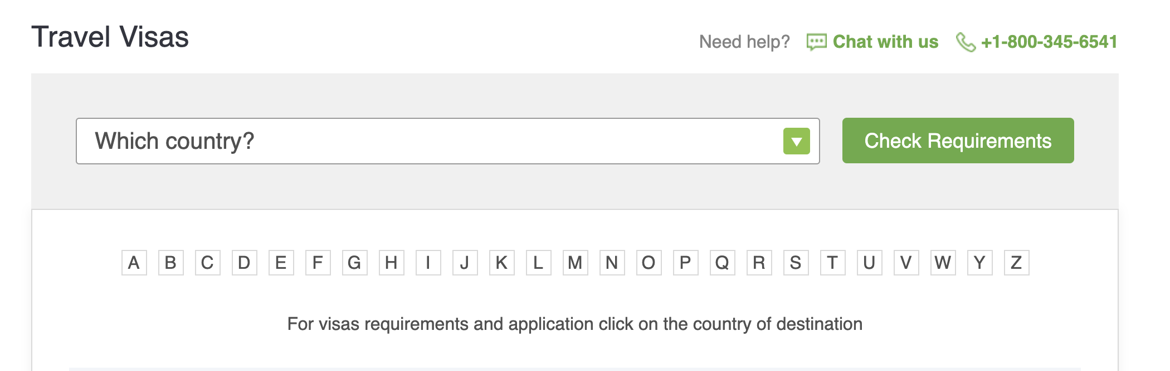
Value added product
We offer a centralized platform for:
Providing the best route possible for multiple destinations.
Visa requirements for all the user stops.
Travel advisories/restrictions
All in just ONE place!!
vs. 3 different sites

Slide 12
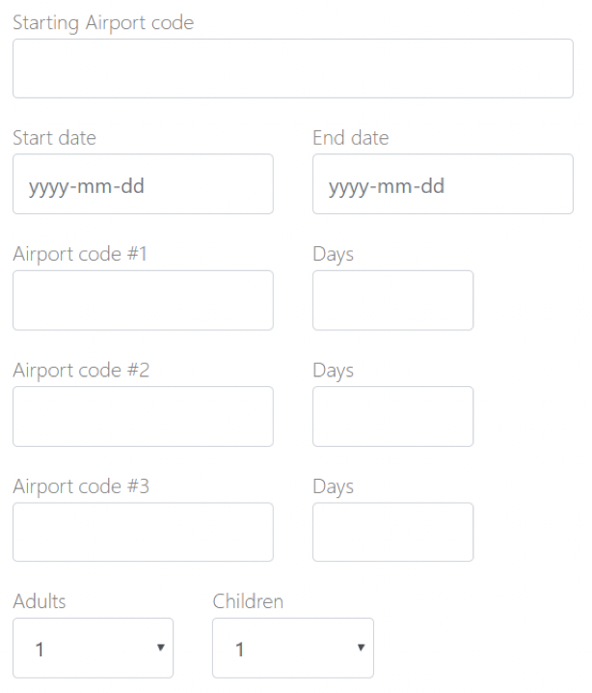
User input vs result
We ask the user the following data:
The user gets:
Best possible route with prices and link to buy directly with airlines.
All possible travel advisories given by the USA Gov.
Any visa requirement during the trip.
Future plans!
Weather forecast for the trip.
What to pack.
Top attractions and restaurants at any given location.

Slide 13
Thank you!!

